Slide 1
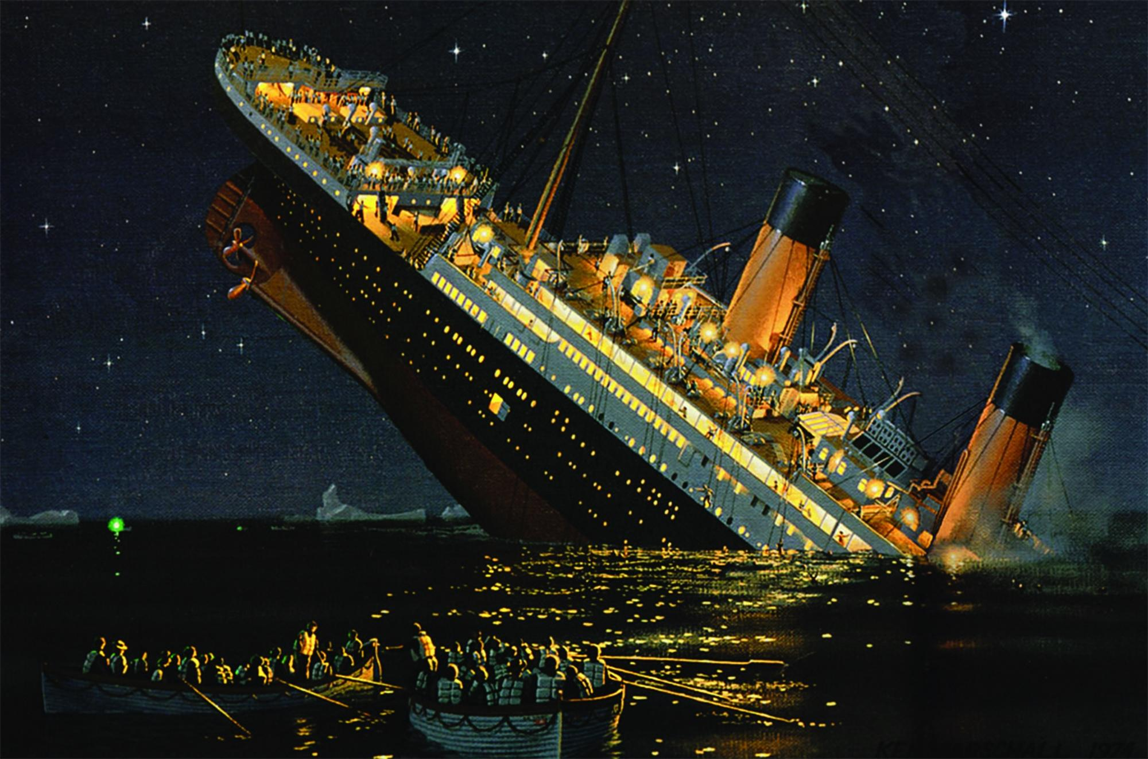
FINAL
PROJECT
(Titanic Dataset)
By:Akarshi Jaiswal

Slide 2
Introduction
Titanic, in full Royal Mail Ship (RMS) Titanic, British luxury passenger liner that sank on April 14–15, 1912, during its maiden voyage, en route to New York City from Southampton, England, killing about 1,500 passengers and ship personnel. One of the most famous tragedies in modern history.
In this project we will be analysing Titanic dataset and try to predict what factors affect the probability of surviving the mishap.

Slide 3
Understanding the problems
01
The train.csv file contains data for 891 of the real Titanic passengers. Each row represents one person. The columns describe different attributes about the person including whether they survived ,their age,sex,fare they paid,passenger class,parent child ratio and no. of siblings.
02
We need to prepare a model in order to make predictions on whether person survived or not,considering the features that greatly impact the probability of surviving.

Slide 4
Software used
Text editor Jupyter notebook 5.7.4
Libraries Required Numpy Pandas Matplotlib Scikit learn

Slide 5



PREVIEW OF DATASET
 | PassengerId | Survived | Pclass | Name | Sex | Age | SibSp | Parch | Ticket | Fare | Cabin | Embarked
0 | 1 | 0 | 3 | Braund, Mr. Owen Harris | male | 22.0 | 1 | 0 | A/5 21171 | 7.2500 | NaN | S
1 | 2 | 1 | 1 | Cumings, Mrs. John Bradley (Florence Briggs Th... | female | 38.0 | 1 | 0 | PC 17599 | 71.2833 | C85 | C
2 | 3 | 1 | 3 | Heikkinen, Miss. Laina | female | 26.0 | 0 | 0 | STON/O2. 3101282 | 7.9250 | NaN | S

Slide 6
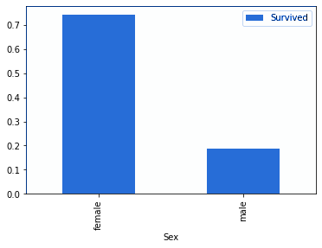
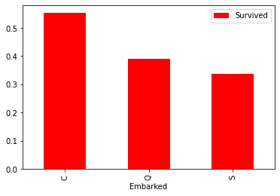
DATA VISUALISATION

Slide 7
DATA PROCESSING
Persona 02
FIRSTLY decide the target column(i.e. Survived)
analyse data types and data shape and change it according to requirements.
Identify columns with null values.
Assign null values with mean,median, mode or use dropna function. (Age,Cabin,Embarked columns possess null values).
Find the no. of unique values in of features.

Slide 8
Feature Selection
For feature selection in our model we are utilising correlation matrix ,also we can find probability of surviving using group by function.
A correlation matrix is a table showing correlation coefficients between variables. Each cell in the table shows the correlation between two variables.
Due to lower coefficients of parch,passenger-id,SibSp we neglect these features.
A value closer to 0 implies weaker correlation (exact 0 implying no correlation)
A value closer to 1 implies stronger positive correlation
A value closer to -1 implies stronger negative correlation

Slide 9
Correlation Matrix obtained
 | PassengerId | Survived | Pclass | Age | SibSp | Parch | Fare
PassengerId | 1.000000 | -0.005007 | -0.035144 | 0.036847 | -0.057527 | -0.001652 | 0.012658
Survived | -0.005007 | 1.000000 | -0.338481 | -0.077221 | -0.035322 | 0.081629 | 0.257307
Pclass | -0.035144 | -0.338481 | 1.000000 | -0.369226 | 0.083081 | 0.018443 | -0.549500
Age | 0.036847 | -0.077221 | -0.369226 | 1.000000 | -0.308247 | -0.189119 | 0.096067
SibSp | -0.057527 | -0.035322 | 0.083081 | -0.308247 | 1.000000 | 0.414838 | 0.159651
Parch | -0.001652 | 0.081629 | 0.018443 | -0.189119 | 0.414838 | 1.000000 | 0.216225
Fare | 0.012658 | 0.257307 | -0.549500 | 0.096067 | 0.159651 | 0.216225 | 1.000000

Slide 10
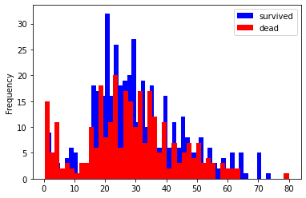
Visual analysis of Age vs surviving frequency

Slide 11
Final dataset
Ready to be used for model building
 | Survived | Pclass | Age | Fare | Sex_female | Sex_male | Embarked_C | Embarked_Q | Embarked_S
0 | 0 | 3 | 22.0 | 7.2500 | 0 | 1 | 0 | 0 | 1
1 | 1 | 1 | 38.0 | 71.2833 | 1 | 0 | 1 | 0 | 0
2 | 1 | 3 | 26.0 | 7.9250 | 1 | 0 | 0 | 0 | 1
3 | 1 | 1 | 35.0 | 53.1000 | 1 | 0 | 0 | 0 | 1
4 | 0 | 3 | 35.0 | 8.0500 | 0 | 1 | 0 | 0 | 1

Slide 12
Algorithms used
Decision
tree
Logistic Regression
Random Forest Tree

Slide 13
Decision Tree
Decision Tree Analysis is a general, predictive modelling tool that has applications spanning a number of different areas. In general, decision trees are constructed via an algorithmic approach that identifies ways to split a data set based on different conditions.
Library: Sklearn.tree
Accuracy: 0.7696629213483146
Confusion matrix:
[[ 88 17]
[ 24 49 ] ]

Slide 14
Logistic Regression
Logistic regression is a classification algorithm used to assign observations to a discrete set of classes. Unlike linear regression which outputs continuous number values, logistic regression transforms its output using the logistic sigmoid function to return a probability value which can then be mapped to two or more discrete classes.
Library: sklearn.linear_model
Accuracy:0.7191011235955056
Confusion matrix:
[[ 85 20]
[ 30 43 ]]

Slide 15
Random Forest Classifier
A random forest is a meta estimator that fits a number of decision tree classifiers on various sub-samples of the dataset and uses averaging to improve the predictive accuracy and control over-fitting.
Library: sklearn.ensemble
Accuracy: 0.792134831460674
Confusion matrix:
[[ 92 13]
[ 24 49 ]]

Slide 16
Experience and learning
Every algorithm gave different results.
No algorithm can have 100% accuracy.
Accuracy of a model can be determined by accuracy score and confusion matrix.
Random forest classifier gave best accuracy score.

Slide 17


